Slide 1
Mockingbird
Advertising campaign

Slide 2
Mockingbird Podcast

Slide 3
Mockingbird Podcast
Advertising Techniques
This podcast uses the Appeal to Plain Folk and Testimonial (by plain folk) advertising techniques. It shows that each of us read and enjoyed Mockingbird, which helps prove that it’s a good book.

Slide 4
Mockingbird Television Commercial

Slide 5
Mockingbird Television Commercial
Advertising Techniques
The commercial uses three advertising techniques. The first one is Appeal to Emotions, by showing the touching story of a girl overcoming grief with the help of Mockingbird. It also uses Appeal to Plain Folk by showing that all of us read and enjoyed the book and it helped us, as well as bandwagon, with the saying “We read Mockingbird and you should too!”

Slide 6
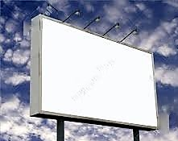
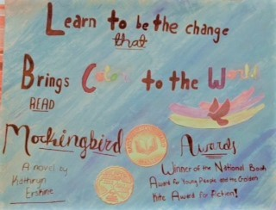
A Billboard Advertising Mockingbird

Slide 7
A Billboard Advertising Mockingbird
Advertising Techniques
The billboard also uses three advertising techniques. First, it appeals t0 the emotions with a thought-provoking message. It also uses a testimonial by talking about the awards that Mockingbird has won, which in themselves prove that experts think Mockingbird is a good and worthwhile book. Finally, the billboard uses a little bit of the Glittering Generalities technique with the nice-looking art and unspecified claims in the slogan it displays.

Slide 8
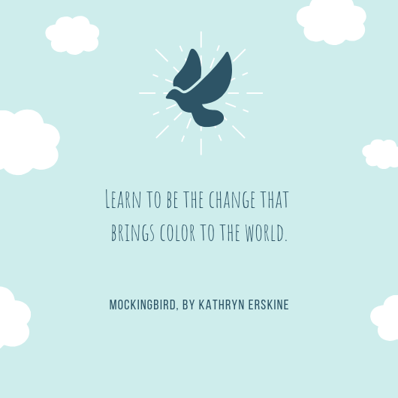
Magazine Ad

Slide 9
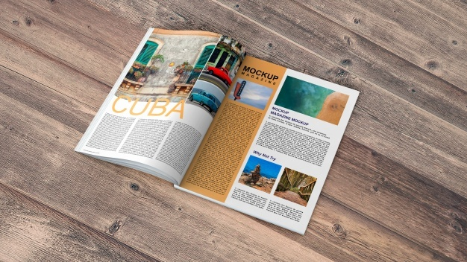

Slide 10
Magazine Ad
Advertising Techniques
The magazine ad Appeals to the Emotions with a thought-provoking message and uses Glittering Generalities as it only vaguely describes what the book has to offer and looks pretty while doing so.

Slide 11
Bumper Sticker

Slide 12
Bumper Sticker

Slide 13
Bumper Sticker
Advertising Techniques
The bumper sticker uses Glittering Generalities to give a vague, lovely description of the book while being eye-catching and pretty. The other advertising technique it uses is Appeal to the Emotions, through its thought-provoking message.

Slide 14
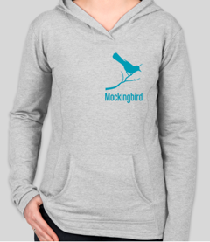
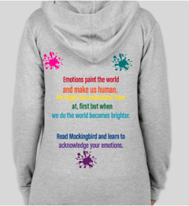
Mockingbird Sweatshirt
Front View
Back View

Slide 15
Mockingbird Sweatshirt
Advertising Techniques
The advertising techniques used by the sweatshirt design are Appeal to the Emotions through the touching and thought-provoking message, and Glittering Generalities in the non-detailed but affirmative format and eye-catching design.

Slide 16
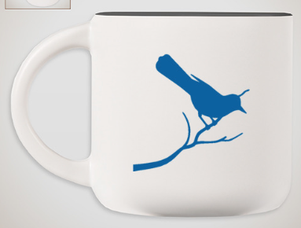
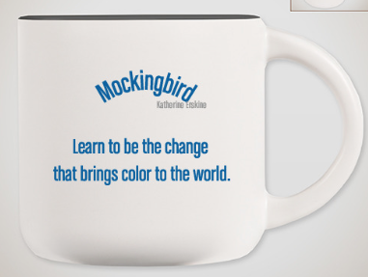
Mockingbird Coffee Mug
Front View
Back View

Slide 17
Mockingbird Coffee Mug
Advertising Techniques
This coffee mug uses two advertising techniques: Appeal to the Emotions and Glittering Generalities. It appeals to the emotions with its thought-provoking and touching message and glitters generally by looking nice, as well as having a vague but sparkly outlook on Mockingbird.

Slide 18
Citations
“Open Magazine Vectors, Photos and PSD Files | Free Download.” Freepik, www.freepik.com/free-photos-vectors/open-magazine.
Junior Library Guild. “Mockingbird.” JLG, May 2010, www.juniorlibraryguild.com/book/landing/detailedview?itemcode=9780399252648J.
“Canva.com.” Canva, Canva, 2012, www.canva.com/design/DADQqvDiZw0/dzLGZTZb0lLjnK7lgRg58Q/edit.
Briscoe, Neil. “First Drive: E-Class Puts Mercedes Back in the Running.” The Irish Times, The Irish Times, 20 Apr. 2016, www.irishtimes.com/life-and-style/motors/first-drive-e-class-puts-mercedes-back-in-the-running-1.2610801. (Photo Citation)
fullcirclelit.blogspot.com/2016/03/john-parra-wins-golden-kite.html. (Photo Citation)
Yin, Maryann. “Longlist Revealed for 2015 National Book Award for Young People's Literature.” – Adweek, Adweek, 14 Sept. 2015, www.adweek.com/galleycat/2015-national-book-award-for-young-peoples-literature-longlist-unveiled/109792. (Photo Citation)
“Templates: Blank Billboard and Pluffy Clouds - Ready for Commercial Advertisement.” FeaturePics, www.featurepics.com/online/Blank-Billboard-Pluffy-Clouds-636623.aspx. . (Photo Citation)

Slide 19
Thank You
for Watching!
Read Mockingbird!

